Slide 1
Analysis of CLOCKED SEQENTIAL CIRCUITS
Lecture No 5

Slide 2
ANALYSIS OF CLOCKED SEQENTIAL CIRCUITS
ANALYSIS describes what circuit will do under certain operation conditions
CLOCKED SEQENTIAL CIRCUIT is one with FLIP FLOPS with a clocked input
STEPS OF ANALYSIS
Circuit Diagram
State Equations
State Table
State Diagram

Slide 3
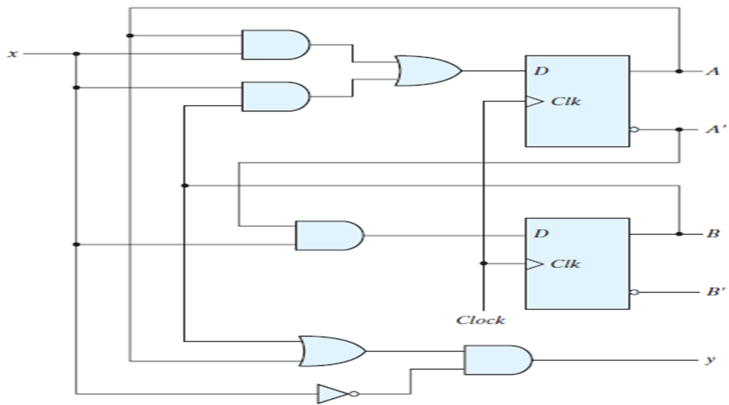
CIRCUIT DIAGRAM

Slide 4
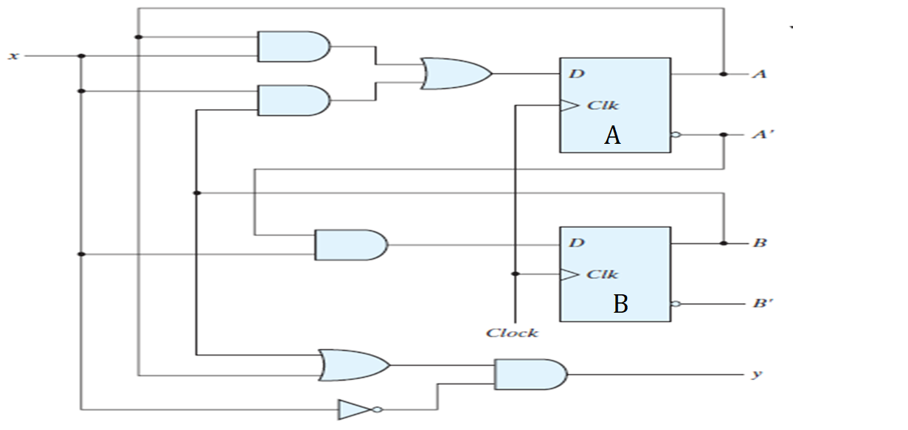
CIRCUIT DIAGRAM

Slide 5
STATE EQUATIONS
TRANSITION EQUATIONS
Describes behavior of CLOCKED SEQUENTIAL CIRCUITS

Slide 6
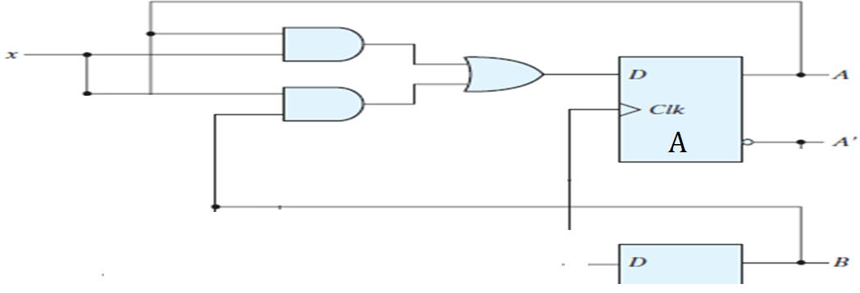
STATE EQUATIONS FOR FLIP FLOP A

Slide 7
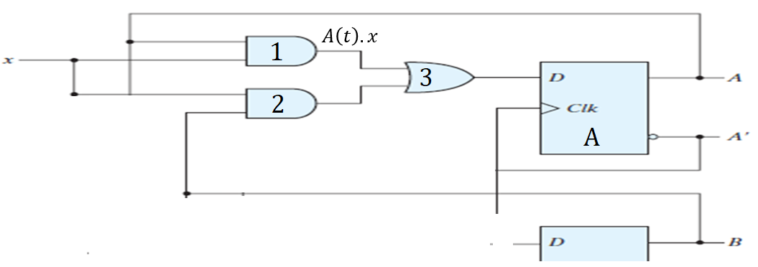

STATE EQUATIONS FOR FLIP FLOP A

Slide 8
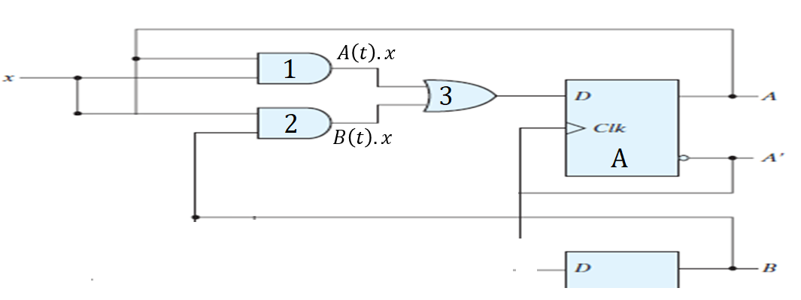

STATE EQUATIONS FOR FLIP FLOP A

Slide 9

STATE EQUATIONS FOR FLIP FLOP A

Slide 10
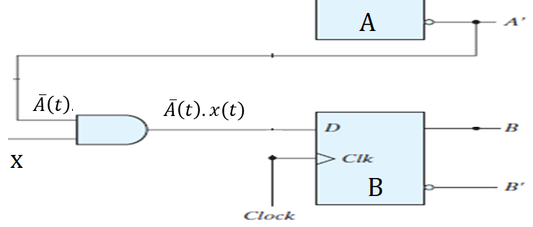

STATE EQUATIONS FOR FLIP FLOP B

Slide 11
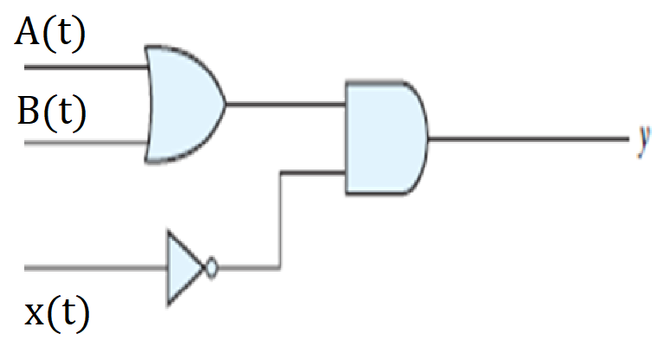

STATE EQUATIONS FOR OUTPUT y

Slide 12
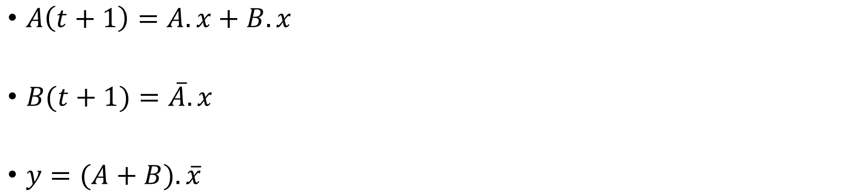
STATE EQUATIONS

Slide 13
STATE TABLE
TRANSITION TABLE
Consist of four Sections
PRESENT STATE
INPUT
NEXT STATE
OUTPUT

Slide 14
STATE TABLE: PRESENT STATE
State of flip flop A and B at any given time t
PRESENT STATE
A | B
0 | 0
0 | 1
1 | 0
1 | 1

Slide 15
STATE TABLE: PRESENT STATE & INPUT
State of flip flop A and B at any given time t
Input gives value of x for each possible present state
PRESENT STATE |  | INPUT
A | B | X
0 | 0 | 0
0 | 0 | 1
0 | 1 | 0
0 | 1 | 1
1 | 0 | 0
1 | 0 | 1
1 | 1 | 0
1 | 1 | 1

Slide 16




STATE TABLE: PRESENT STATE,INPUT & NEXT STATE
Next state for A(t+1)
PRESENT STATE |  | INPUT | NEXT STATE
A | B | X | A(t+1)
0 | 0 | 0 | 0
0 | 0 | 1
0 | 1 | 0
0 | 1 | 1
1 | 0 | 0
1 | 0 | 1
1 | 1 | 0
1 | 1 | 1
Where A=0, B=0, x=0

Slide 17

STATE TABLE: PRESENT STATE,INPUT & NEXT STATE
Next state for A(t+1)
PRESENT STATE |  | INPUT | NEXT STATE
A | B | X | A(t+1)
0 | 0 | 0 | 0
0 | 0 | 1 | 0
0 | 1 | 0
0 | 1 | 1
1 | 0 | 0
1 | 0 | 1
1 | 1 | 0
1 | 1 | 1
Where A=0, B=0, x=1

Slide 18

STATE TABLE: PRESENT STATE,INPUT & NEXT STATE
Next state for A(t+1)
PRESENT STATE |  | INPUT | OUTPUT
A | B | X | A(t+1)
0 | 0 | 0 | 0
0 | 0 | 1 | 0
0 | 1 | 0 | 0
0 | 1 | 1
1 | 0 | 0
1 | 0 | 1
1 | 1 | 0
1 | 1 | 1
Where A=0, B=1, x=0

Slide 19



STATE TABLE: PRESENT STATE,INPUT & NEXT STATE
Next state for A(t+1)
PRESENT STATE |  | INPUT | NEXT STATE
A | B | X | A(t+1)
0 | 0 | 0 | 0
0 | 0 | 1 | 0
0 | 1 | 0 | 0
0 | 1 | 1 | 1
1 | 0 | 0
1 | 0 | 1
1 | 1 | 0
1 | 1 | 1
Where A=0, B=1, x=1

Slide 20
STATE TABLE: PRESENT STATE,INPUT & NEXT STATE
Next state for A(t+1)
PRESENT STATE |  | INPUT | NEXT STATE
A | B | X | A
0 | 0 | 0 | 0
0 | 0 | 1 | 0
0 | 1 | 0 | 0
0 | 1 | 1 | 1
1 | 0 | 0 | 0
1 | 0 | 1 | 1
1 | 1 | 0 | 0
1 | 1 | 1 | 1

Slide 21





STATE TABLE: PRESENT STATE,INPUT & NEXT STATE
Next state for B(t+1)
PRESENT STATE |  | INPUT | NEXT STATE
A | B | X | A | B(t+1)
0 | 0 | 0 | 0 | 0
0 | 0 | 1 | 0
0 | 1 | 0 | 0 | 0
0 | 1 | 1 | 1
1 | 0 | 0 | 0
1 | 0 | 1 | 0
1 | 1 | 0 | 0
1 | 1 | 1 | 1

Slide 22




STATE TABLE: PRESENT STATE,INPUT & NEXT STATE
Next state for B(t+1)
PRESENT STATE |  | INPUT | NEXT STATE
A | B | X | A | B(t+1)
0 | 0 | 0 | 0 | 0
0 | 0 | 1 | 0 | 1
0 | 1 | 0 | 0 | 0
0 | 1 | 1 | 1 | 1
1 | 0 | 0 | 0
1 | 0 | 1 | 0
1 | 1 | 0 | 0
1 | 1 | 1 | 1

Slide 23
STATE TABLE: PRESENT STATE,INPUT & NEXT STATE
Next state for B(t+1)
PRESENT STATE |  | INPUT | NEXT STATE
A | B | X | A | B
0 | 0 | 0 | 0 | 0
0 | 0 | 1 | 0 | 1
0 | 1 | 0 | 0 | 0
0 | 1 | 1 | 1 | 1
1 | 0 | 0 | 0 | 0
1 | 0 | 1 | 0 | 0
1 | 1 | 0 | 0 | 0
1 | 1 | 1 | 1 | 0

Slide 24





STATE TABLE: PRESENT STATE, INPUT, NEXT STATE & OUTPUT
OUTPUT
PRESENT STATE |  | INPUT | NEXT STATE |  | OUTPUT
A | B | X | A | B | y
0 | 0 | 0 | 0 | 0 | 0
0 | 0 | 1 | 0 | 1
0 | 1 | 0 | 0 | 0
0 | 1 | 1 | 1 | 1
1 | 0 | 0 | 0 | 0
1 | 0 | 1 | 0 | 0
1 | 1 | 0 | 0 | 0
1 | 1 | 1 | 1 | 0

Slide 25



STATE TABLE: PRESENT STATE, INPUT, NEXT STATE & OUTPUT
OUTPUT
PRESENT STATE |  | INPUT | NEXT STATE |  | OUTPUT
A | B | X | A | B | y
0 | 0 | 0 | 0 | 0 | 0
0 | 0 | 1 | 0 | 1 | 0
0 | 1 | 0 | 0 | 0
0 | 1 | 1 | 1 | 1
1 | 0 | 0 | 0 | 0
1 | 0 | 1 | 0 | 0
1 | 1 | 0 | 0 | 0
1 | 1 | 1 | 1 | 0

Slide 26




STATE TABLE: PRESENT STATE, INPUT, NEXT STATE & OUTPUT
OUTPUT
PRESENT STATE |  | INPUT | NEXT STATE |  | OUTPUT
A | B | X | A | B | y
0 | 0 | 0 | 0 | 0 | 0
0 | 0 | 1 | 0 | 1 | 0
0 | 1 | 0 | 0 | 0 | 1
0 | 1 | 1 | 1 | 1
1 | 0 | 0 | 0 | 0
1 | 0 | 1 | 0 | 0
1 | 1 | 0 | 0 | 0
1 | 1 | 1 | 1 | 0

Slide 27



STATE TABLE: PRESENT STATE, INPUT, NEXT STATE & OUTPUT
OUTPUT
PRESENT STATE |  | INPUT | NEXT STATE |  | OUTPUT
A | B | X | A | B | y
0 | 0 | 0 | 0 | 0 | 0
0 | 0 | 1 | 0 | 1 | 0
0 | 1 | 0 | 0 | 0 | 1
0 | 1 | 1 | 1 | 1 | 0
1 | 0 | 0 | 0 | 0
1 | 0 | 1 | 0 | 0
1 | 1 | 0 | 0 | 0
1 | 1 | 1 | 1 | 0

Slide 28


STATE TABLE: PRESENT STATE, INPUT, NEXT STATE & OUTPUT
OUTPUT
PRESENT STATE |  | INPUT | NEXT STATE |  | OUTPUT
A | B | X | A | B | y
0 | 0 | 0 | 0 | 0 | 0
0 | 0 | 1 | 0 | 1 | 0
0 | 1 | 0 | 0 | 0 | 1
0 | 1 | 1 | 1 | 1 | 0
1 | 0 | 0 | 0 | 0 | 1
1 | 0 | 1 | 0 | 0 | 0
1 | 1 | 0 | 0 | 0 | 1
1 | 1 | 1 | 1 | 0 | 0

Slide 29
STATE TABLE: PRESENT STATE, INPUT, NEXT STATE & OUTPUT
PRESENT STATE |  | NEXT STATE |  |  |  | OUTPUT
 |  | x=0 |  | x=1 |  | x=0 | x=1
A | B | A | B | A | B | y | y
0 | 0
0 | 1
1 | 0
1 | 1
PRESENT STATE |  | INPUT | NEXT STATE |  | OUTPUT
A | B | X | A | B | y
0 | 0 | 0 | 0 | 0 | 0
0 | 0 | 1 | 0 | 1 | 0
0 | 1 | 0 | 0 | 0 | 1
0 | 1 | 1 | 1 | 1 | 0
1 | 0 | 0 | 0 | 0 | 1
1 | 0 | 1 | 0 | 0 | 0
1 | 1 | 0 | 0 | 0 | 1
1 | 1 | 1 | 1 | 0 | 0

Slide 30
STATE TABLE: PRESENT STATE, INPUT, NEXT STATE & OUTPUT
PRESENT STATE |  | NEXT STATE |  |  |  | OUTPUT
 |  | x=0 |  | x=1 |  | x=0 | x=1
A | B | A | B | A | B | y | y
0 | 0 | 0 | 0 |  |  | 0
0 | 1
1 | 0
1 | 1
PRESENT STATE |  | INPUT | NEXT STATE |  | OUTPUT
A | B | X | A | B | y
0 | 0 | 0 | 0 | 0 | 0
0 | 0 | 1 | 0 | 1 | 0
0 | 1 | 0 | 0 | 0 | 1
0 | 1 | 1 | 1 | 1 | 0
1 | 0 | 0 | 0 | 0 | 1
1 | 0 | 1 | 0 | 0 | 0
1 | 1 | 0 | 0 | 0 | 1
1 | 1 | 1 | 1 | 0 | 0

Slide 31
STATE TABLE: PRESENT STATE, INPUT, NEXT STATE & OUTPUT
PRESENT STATE |  | NEXT STATE |  |  |  | OUTPUT
 |  | x=0 |  | x=1 |  | x=0 | x=1
A | B | A | B | A | B | y | y
0 | 0 | 0 | 0 | 0 | 1 | 0 | 0
0 | 1
1 | 0
1 | 1
PRESENT STATE |  | INPUT | NEXT STATE |  | OUTPUT
A | B | X | A | B | y
0 | 0 | 0 | 0 | 0 | 0
0 | 0 | 1 | 0 | 1 | 0
0 | 1 | 0 | 0 | 0 | 1
0 | 1 | 1 | 1 | 1 | 0
1 | 0 | 0 | 0 | 0 | 1
1 | 0 | 1 | 0 | 0 | 0
1 | 1 | 0 | 0 | 0 | 1
1 | 1 | 1 | 1 | 0 | 0

Slide 32
STATE TABLE: PRESENT STATE, INPUT, NEXT STATE & OUTPUT
PRESENT STATE |  | NEXT STATE |  |  |  | OUTPUT
 |  | x=0 |  | x=1 |  | x=0 | x=1
A | B | A | B | A | B | y | y
0 | 0 | 0 | 0 | 0 | 1 | 0 | 0
0 | 1 | 0 | 0 |  |  | 1
1 | 0
1 | 1
PRESENT STATE |  | INPUT | NEXT STATE |  | OUTPUT
A | B | X | A | B | y
0 | 0 | 0 | 0 | 0 | 0
0 | 0 | 1 | 0 | 1 | 0
0 | 1 | 0 | 0 | 0 | 1
0 | 1 | 1 | 1 | 1 | 0
1 | 0 | 0 | 0 | 0 | 1
1 | 0 | 1 | 0 | 0 | 0
1 | 1 | 0 | 0 | 0 | 1
1 | 1 | 1 | 1 | 0 | 0

Slide 33
STATE TABLE: PRESENT STATE, INPUT, NEXT STATE & OUTPUT
PRESENT STATE |  | NEXT STATE |  |  |  | OUTPUT
 |  | x=0 |  | x=1 |  | x=0 | x=1
A | B | A | B | A | B | y | y
0 | 0 | 0 | 0 | 0 | 1 | 0 | 0
0 | 1 | 0 | 0 | 1 | 1 | 1 | 0
1 | 0
1 | 1
PRESENT STATE |  | INPUT | NEXT STATE |  | OUTPUT
A | B | X | A | B | y
0 | 0 | 0 | 0 | 0 | 0
0 | 0 | 1 | 0 | 1 | 0
0 | 1 | 0 | 0 | 0 | 1
0 | 1 | 1 | 1 | 1 | 0
1 | 0 | 0 | 0 | 0 | 1
1 | 0 | 1 | 0 | 0 | 0
1 | 1 | 0 | 0 | 0 | 1
1 | 1 | 1 | 1 | 0 | 0

Slide 34
STATE TABLE: PRESENT STATE, INPUT, NEXT STATE & OUTPUT
PRESENT STATE |  | NEXT STATE |  |  |  | OUTPUT
 |  | x=0 |  | x=1 |  | x=0 | x=1
A | B | A | B | A | B | y | y
0 | 0 | 0 | 0 | 0 | 1 | 0 | 0
0 | 1 | 0 | 0 | 1 | 1 | 1 | 0
1 | 0 | 0 | 0 | 1 | 0 | 1 | 0
1 | 1 | 0 | 0 | 1 | 0 | 1 | 0
PRESENT STATE |  | INPUT | NEXT STATE |  | OUTPUT
A | B | X | A | B | y
0 | 0 | 0 | 0 | 0 | 0
0 | 0 | 1 | 0 | 1 | 0
0 | 1 | 0 | 0 | 0 | 1
0 | 1 | 1 | 1 | 1 | 0
1 | 0 | 0 | 0 | 0 | 1
1 | 0 | 1 | 0 | 0 | 0
1 | 1 | 0 | 0 | 0 | 1
1 | 1 | 1 | 1 | 0 | 0

Slide 35
STATE TABLE:
PRESENT STATE |  | NEXT STATE |  |  |  | OUTPUT
 |  | x=0 |  | x=1 |  | x=0 | x=1
A | B | A | B | A | B | y | y
0 | 0 | 0 | 0 | 0 | 1 | 0 | 0
0 | 1 | 0 | 0 | 1 | 1 | 1 | 0
1 | 0 | 0 | 0 | 1 | 0 | 1 | 0
1 | 1 | 0 | 0 | 1 | 0 | 1 | 0

Slide 36
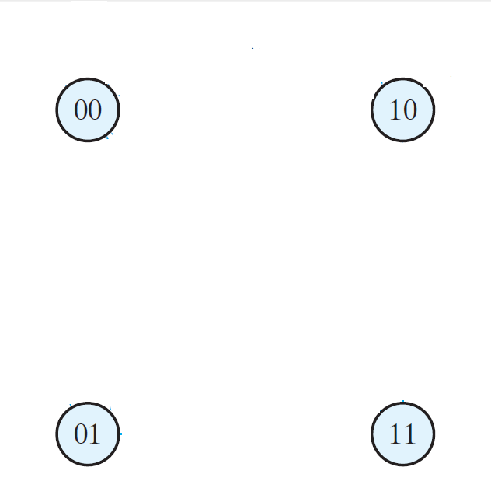
STATE DIAGRAM:
PRESENT STATE |  | NEXT STATE |  |  |  | OUTPUT
 |  | x=0 |  | x=1 |  | x=0 | x=1
A | B | A | B | A | B | y | y
0 | 0 | 0 | 0 | 0 | 1 | 0 | 0
0 | 1 | 0 | 0 | 1 | 1 | 1 | 0
1 | 0 | 0 | 0 | 1 | 0 | 1 | 0
1 | 1 | 0 | 0 | 1 | 0 | 1 | 0

Slide 37
STATE DIAGRAM:
PRESENT STATE |  | NEXT STATE |  |  |  | OUTPUT
 |  | x=0 |  | x=1 |  | x=0 | x=1
A | B | A | B | A | B | y | y
0 | 0 | 0 | 0 | 0 | 1 | 0 | 0
0 | 1 | 0 | 0 | 1 | 1 | 1 | 0
1 | 0 | 0 | 0 | 1 | 0 | 1 | 0
1 | 1 | 0 | 0 | 1 | 0 | 1 | 0

Slide 38
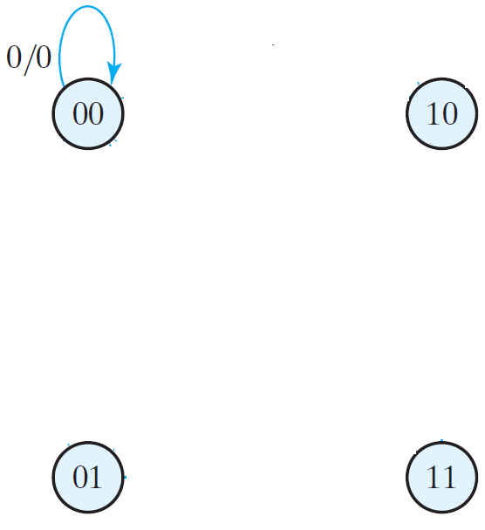
STATE DIAGRAM:
PRESENT STATE |  | NEXT STATE |  |  |  | OUTPUT
 |  | x=0 |  | x=1 |  | x=0 | x=1
A | B | A | B | A | B | y | y
0 | 0 | 0 | 0 | 0 | 1 | 0 | 0
0 | 1 | 0 | 0 | 1 | 1 | 1 | 0
1 | 0 | 0 | 0 | 1 | 0 | 1 | 0
1 | 1 | 0 | 0 | 1 | 0 | 1 | 0
INPUT/OUTPUT

Slide 39
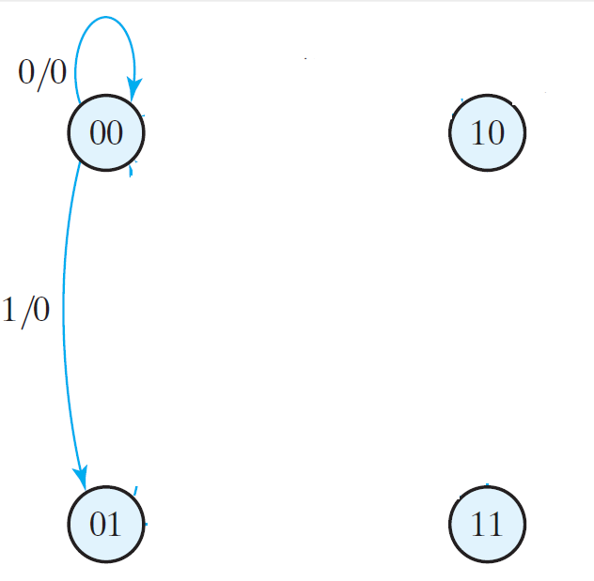
STATE DIAGRAM:
PRESENT STATE |  | NEXT STATE |  |  |  | OUTPUT
 |  | x=0 |  | x=1 |  | x=0 | x=1
A | B | A | B | A | B | y | y
0 | 0 | 0 | 0 | 0 | 1 | 0 | 0
0 | 1 | 0 | 0 | 1 | 1 | 1 | 0
1 | 0 | 0 | 0 | 1 | 0 | 1 | 0
1 | 1 | 0 | 0 | 1 | 0 | 1 | 0

Slide 40
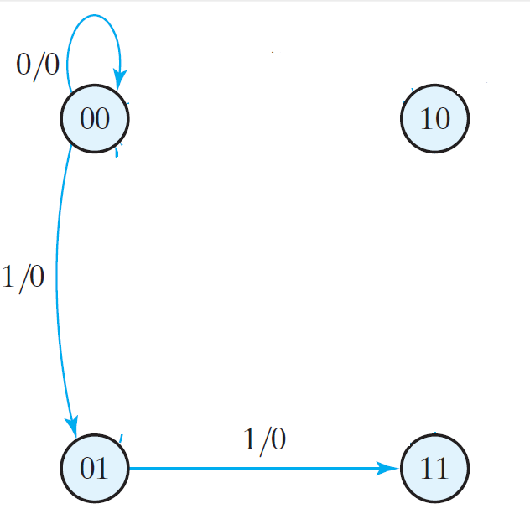
STATE DIAGRAM:
PRESENT STATE |  | NEXT STATE |  |  |  | OUTPUT
 |  | x=0 |  | x=1 |  | x=0 | x=1
A | B | A | B | A | B | y | y
0 | 0 | 0 | 0 | 0 | 1 | 0 | 0
0 | 1 | 0 | 0 | 1 | 1 | 1 | 0
1 | 0 | 0 | 0 | 1 | 0 | 1 | 0
1 | 1 | 0 | 0 | 1 | 0 | 1 | 0

Slide 41
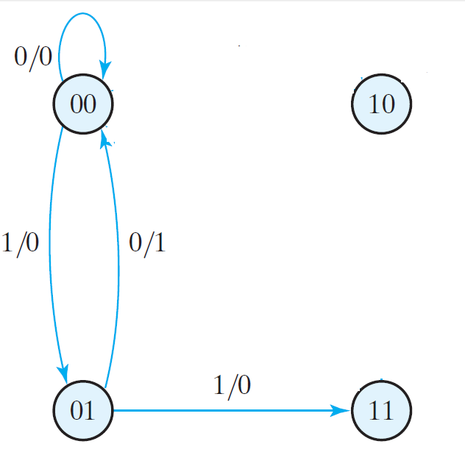
STATE DIAGRAM:
PRESENT STATE |  | NEXT STATE |  |  |  | OUTPUT
 |  | x=0 |  | x=1 |  | x=0 | x=1
A | B | A | B | A | B | y | y
0 | 0 | 0 | 0 | 0 | 1 | 0 | 0
0 | 1 | 0 | 0 | 1 | 1 | 1 | 0
1 | 0 | 0 | 0 | 1 | 0 | 1 | 0
1 | 1 | 0 | 0 | 1 | 0 | 1 | 0

Slide 42
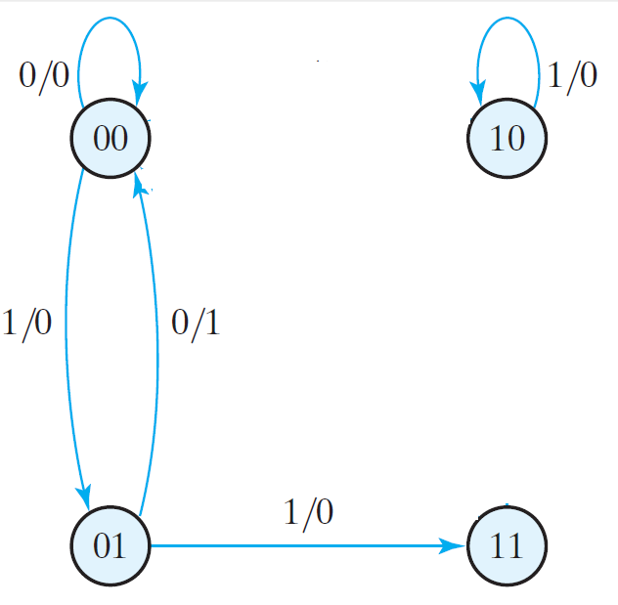
STATE DIAGRAM:
PRESENT STATE |  | NEXT STATE |  |  |  | OUTPUT
 |  | x=0 |  | x=1 |  | x=0 | x=1
A | B | A | B | A | B | y | y
0 | 0 | 0 | 0 | 0 | 1 | 0 | 0
0 | 1 | 0 | 0 | 1 | 1 | 1 | 0
1 | 0 | 0 | 0 | 1 | 0 | 1 | 0
1 | 1 | 0 | 0 | 1 | 0 | 1 | 0

Slide 43
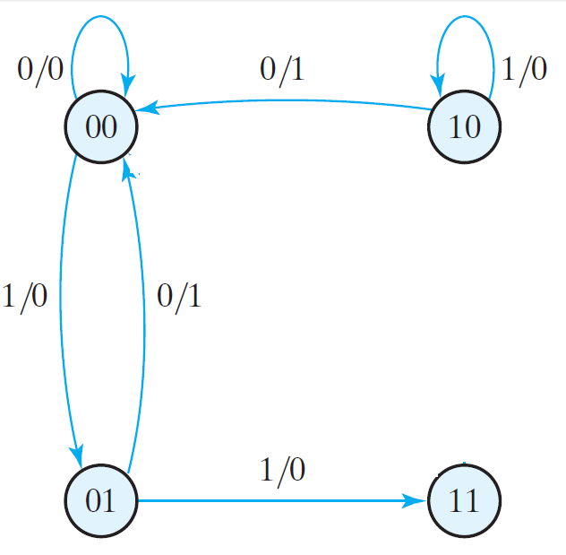
STATE DIAGRAM:
PRESENT STATE |  | NEXT STATE |  |  |  | OUTPUT
 |  | x=0 |  | x=1 |  | x=0 | x=1
A | B | A | B | A | B | y | y
0 | 0 | 0 | 0 | 0 | 1 | 0 | 0
0 | 1 | 0 | 0 | 1 | 1 | 1 | 0
1 | 0 | 0 | 0 | 1 | 0 | 1 | 0
1 | 1 | 0 | 0 | 1 | 0 | 1 | 0

Slide 44
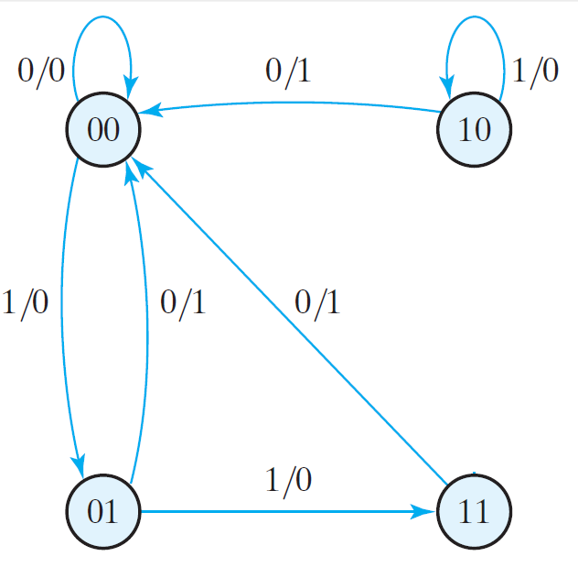
STATE DIAGRAM:
PRESENT STATE |  | NEXT STATE |  |  |  | OUTPUT
 |  | x=0 |  | x=1 |  | x=0 | x=1
A | B | A | B | A | B | y | y
0 | 0 | 0 | 0 | 0 | 1 | 0 | 0
0 | 1 | 0 | 0 | 1 | 1 | 1 | 0
1 | 0 | 0 | 0 | 1 | 0 | 1 | 0
1 | 1 | 0 | 0 | 1 | 0 | 1 | 0

Slide 45
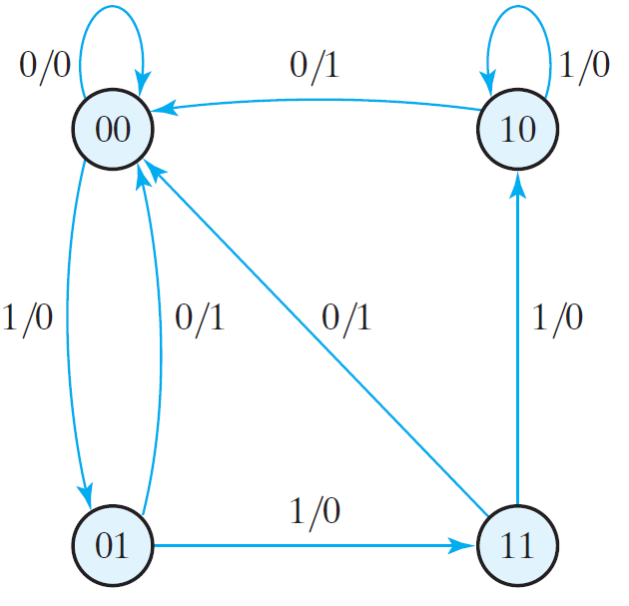
STATE DIAGRAM:
PRESENT STATE |  | NEXT STATE |  |  |  | OUTPUT
 |  | x=0 |  | x=1 |  | x=0 | x=1
A | B | A | B | A | B | y | y
0 | 0 | 0 | 0 | 0 | 1 | 0 | 0
0 | 1 | 0 | 0 | 1 | 1 | 1 | 0
1 | 0 | 0 | 0 | 1 | 0 | 1 | 0
1 | 1 | 0 | 0 | 1 | 0 | 1 | 0

Slide 46
STATE DIAGRAM:
PRESENT STATE |  | NEXT STATE |  |  |  | OUTPUT
 |  | x=0 |  | x=1 |  | x=0 | x=1
A | B | A | B | A | B | y | y
0 | 0 | 0 | 0 | 0 | 1 | 0 | 0
0 | 1 | 0 | 0 | 1 | 1 | 1 | 0
1 | 0 | 0 | 0 | 1 | 0 | 1 | 0
1 | 1 | 0 | 0 | 1 | 0 | 1 | 0

Slide 47
ANALYSIS OF CLOCKED SEQENTIAL CIRCUITS

Slide 48
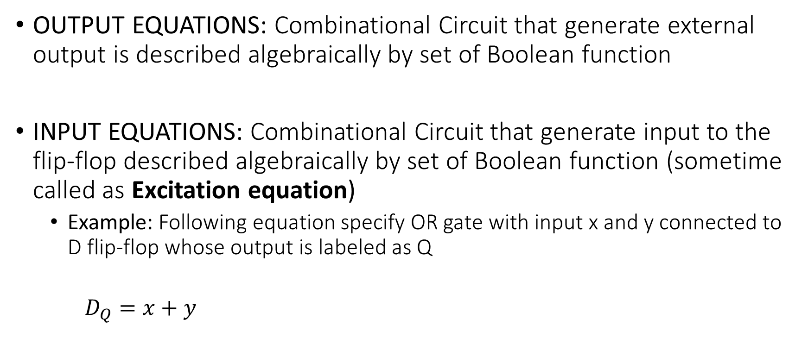
FLIP FLOP EQUATIONS

Slide 49
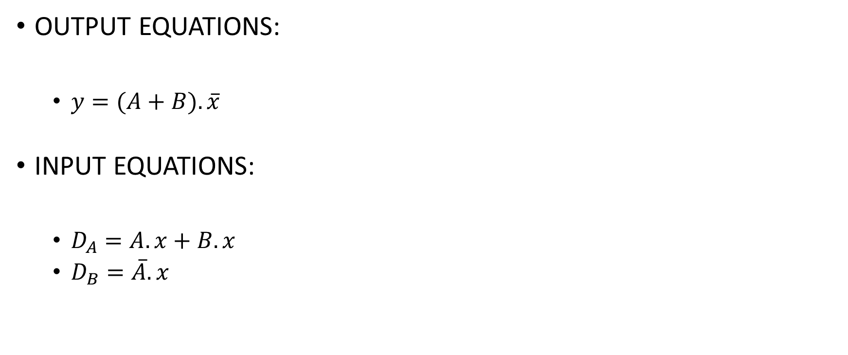
FLIP FLOP EQUATIONS

Slide 50
Analysis of CLOCKED SEQENTIAL CIRCUITS
EXAMPLE 2

Slide 51
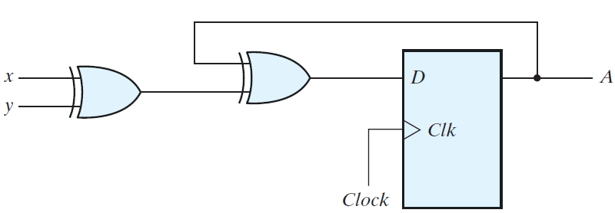


CIRCUIT DIAGRAM
STATE EQUATION (INPUT EQUATION)

Slide 52


STATE EQUATION (INPUT EQUATION)

Slide 53
STATE TABLE: PRESENT STATE
State of flip flop A
PRESENT STATE
A
0
1

Slide 54
STATE TABLE: PRESENT STATE,INPUT
INPUT x and y
PRESENT STATE | INPUT
A | x | y
0 | 0 | 0
0 | 0 | 1
0 | 1 | 0
0 | 1 | 1
1 | 0 | 0
1 | 0 | 1
1 | 1 | 0
1 | 1 | 1

Slide 55


STATE TABLE: PRESENT STATE,INPUT
Next state for A(t+1)
PRESENT STATE | INPUT |  | NEXT STATE
A | x | y | A(t+1)
0 | 0 | 0 | 0
0 | 0 | 1
0 | 1 | 0
0 | 1 | 1
1 | 0 | 0
1 | 0 | 1
1 | 1 | 0
1 | 1 | 1

Slide 56
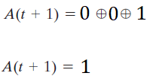
STATE TABLE: PRESENT STATE,INPUT
Next state for A(t+1)
PRESENT STATE | INPUT |  | NEXT STATE
A | x | y | A(t+1)
0 | 0 | 0 | 0
0 | 0 | 1 | 1
0 | 1 | 0
0 | 1 | 1
1 | 0 | 0
1 | 0 | 1
1 | 1 | 0
1 | 1 | 1

Slide 57
STATE TABLE: PRESENT STATE,INPUT, NEXT STATE
Next state for A(t+1)
PRESENT STATE | INPUT |  | NEXT STATE
A | x | y | A(t+1)
0 | 0 | 0 | 0
0 | 0 | 1 | 1
0 | 1 | 0 | 1
0 | 1 | 1 | 0
1 | 0 | 0 | 1
1 | 0 | 1 | 0
1 | 1 | 0 | 0
1 | 1 | 1 | 1

Slide 58
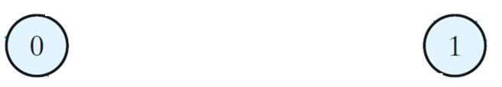
STATE DIAGRAM:
PRESENT STATE | INPUT |  | NEXT STATE
A | x | y | A(t+1)
0 | 0 | 0 | 0
0 | 0 | 1 | 1
0 | 1 | 0 | 1
0 | 1 | 1 | 0
1 | 0 | 0 | 1
1 | 0 | 1 | 0
1 | 1 | 0 | 0
1 | 1 | 1 | 1

Slide 59
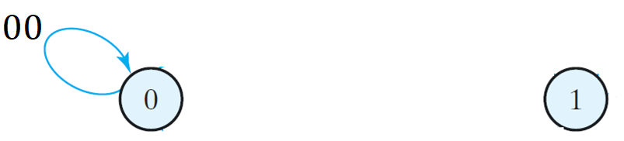
STATE DIAGRAM:
PRESENT STATE | INPUT |  | NEXT STATE
A | x | y | A(t+1)
0 | 0 | 0 | 0
0 | 0 | 1 | 1
0 | 1 | 0 | 1
0 | 1 | 1 | 0
1 | 0 | 0 | 1
1 | 0 | 1 | 0
1 | 1 | 0 | 0
1 | 1 | 1 | 1

Slide 60
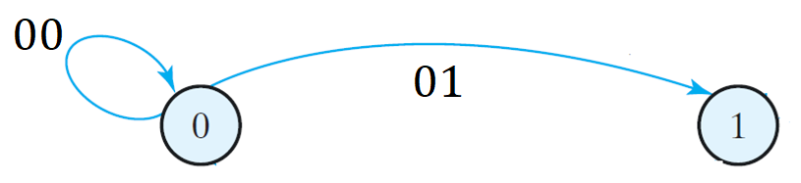
STATE DIAGRAM:
PRESENT STATE | INPUT |  | NEXT STATE
A | x | y | A(t+1)
0 | 0 | 0 | 0
0 | 0 | 1 | 1
0 | 1 | 0 | 1
0 | 1 | 1 | 0
1 | 0 | 0 | 1
1 | 0 | 1 | 0
1 | 1 | 0 | 0
1 | 1 | 1 | 1

Slide 61
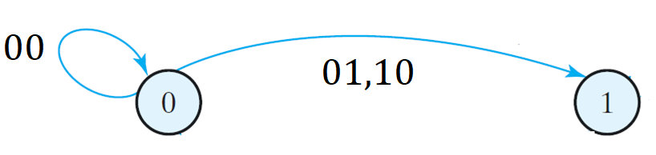
STATE DIAGRAM:
PRESENT STATE | INPUT |  | NEXT STATE
A | x | y | A(t+1)
0 | 0 | 0 | 0
0 | 0 | 1 | 1
0 | 1 | 0 | 1
0 | 1 | 1 | 0
1 | 0 | 0 | 1
1 | 0 | 1 | 0
1 | 1 | 0 | 0
1 | 1 | 1 | 1

Slide 62
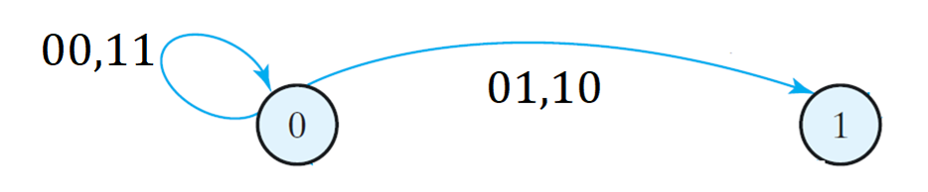
STATE DIAGRAM:
PRESENT STATE | INPUT |  | NEXT STATE
A | x | y | A(t+1)
0 | 0 | 0 | 0
0 | 0 | 1 | 1
0 | 1 | 0 | 1
0 | 1 | 1 | 0
1 | 0 | 0 | 1
1 | 0 | 1 | 0
1 | 1 | 0 | 0
1 | 1 | 1 | 1

Slide 63
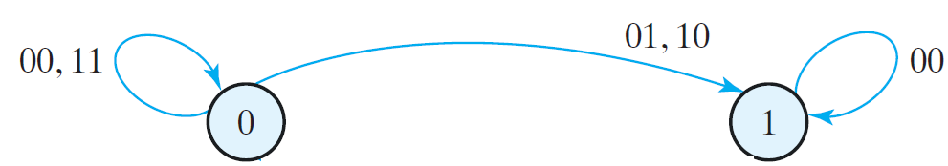
STATE DIAGRAM:
PRESENT STATE | INPUT |  | NEXT STATE
A | x | y | A(t+1)
0 | 0 | 0 | 0
0 | 0 | 1 | 1
0 | 1 | 0 | 1
0 | 1 | 1 | 0
1 | 0 | 0 | 1
1 | 0 | 1 | 0
1 | 1 | 0 | 0
1 | 1 | 1 | 1

Slide 64
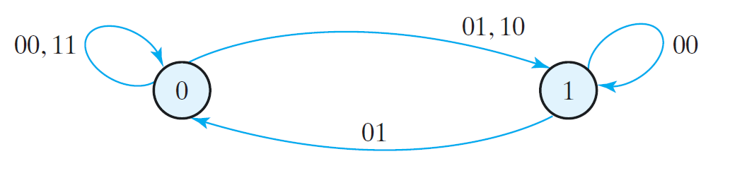
STATE DIAGRAM:
PRESENT STATE | INPUT |  | NEXT STATE
A | x | y | A(t+1)
0 | 0 | 0 | 0
0 | 0 | 1 | 1
0 | 1 | 0 | 1
0 | 1 | 1 | 0
1 | 0 | 0 | 1
1 | 0 | 1 | 0
1 | 1 | 0 | 0
1 | 1 | 1 | 1

Slide 65
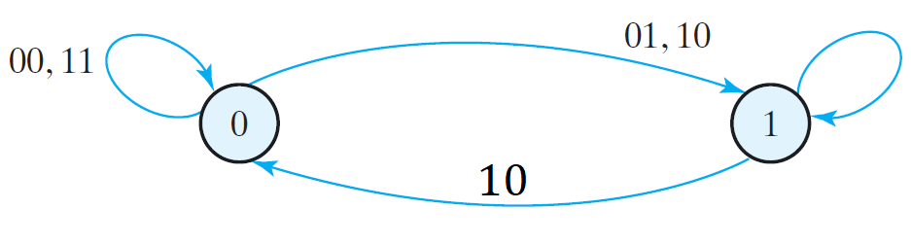
STATE DIAGRAM:
PRESENT STATE | INPUT |  | NEXT STATE
A | x | y | A(t+1)
0 | 0 | 0 | 0
0 | 0 | 1 | 1
0 | 1 | 0 | 1
0 | 1 | 1 | 0
1 | 0 | 0 | 1
1 | 0 | 1 | 0
1 | 1 | 0 | 0
1 | 1 | 1 | 1

Slide 66
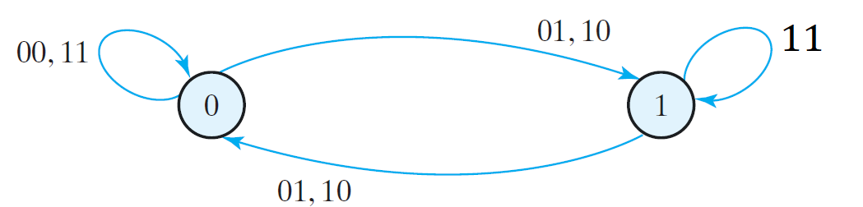
STATE DIAGRAM:
PRESENT STATE | INPUT |  | NEXT STATE
A | x | y | A(t+1)
0 | 0 | 0 | 0
0 | 0 | 1 | 1
0 | 1 | 0 | 1
0 | 1 | 1 | 0
1 | 0 | 0 | 1
1 | 0 | 1 | 0
1 | 1 | 0 | 0
1 | 1 | 1 | 1

Slide 67
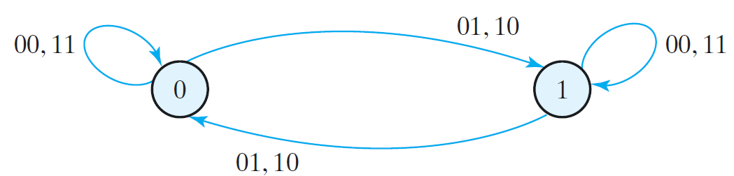
STATE DIAGRAM:
PRESENT STATE | INPUT |  | NEXT STATE
A | x | y | A(t+1)
0 | 0 | 0 | 0
0 | 0 | 1 | 1
0 | 1 | 0 | 1
0 | 1 | 1 | 0
1 | 0 | 0 | 1
1 | 0 | 1 | 0
1 | 1 | 0 | 0
1 | 1 | 1 | 1

Slide 68
Analysis of CLOCKED SEQENTIAL CIRCUITS
Using JK FLIP-FLOP

Slide 69
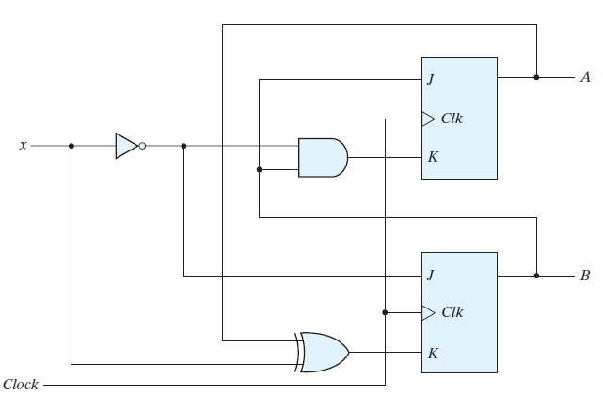
CIRCUIT DIAGRAM

Slide 70
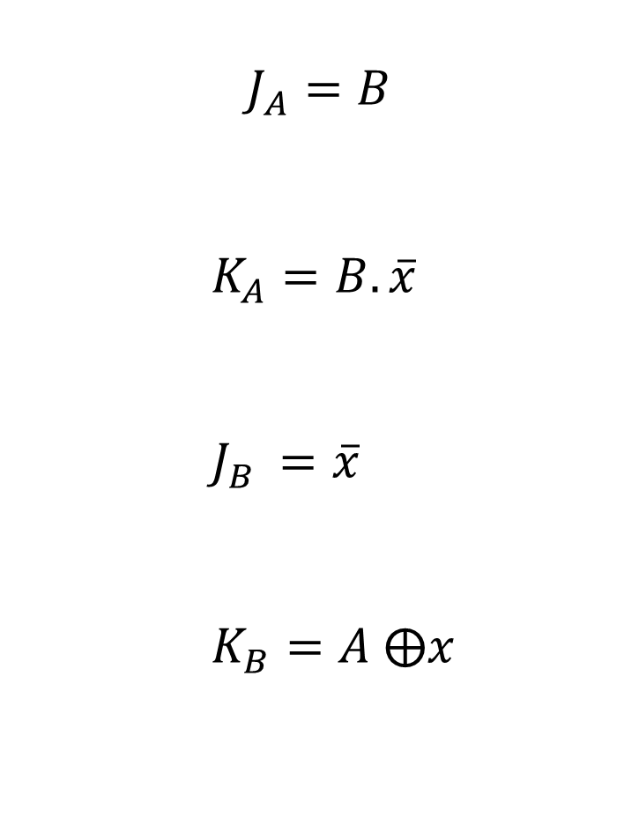
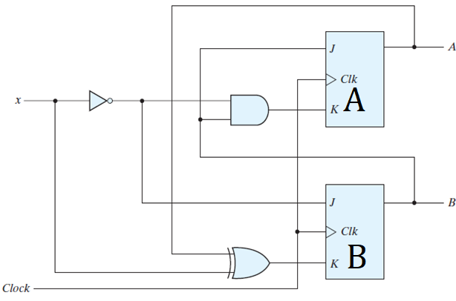
STATE EQUATIONS

Slide 71
STATE TABLE: PRESENT STATE & INPUT
PRESENT STATE |  | INPUT
A | B | x
0 | 0 | 0
0 | 0 | 1
0 | 1 | 0
0 | 1 | 1
1 | 0 | 0
1 | 0 | 1
1 | 1 | 0
1 | 1 | 1

Slide 72
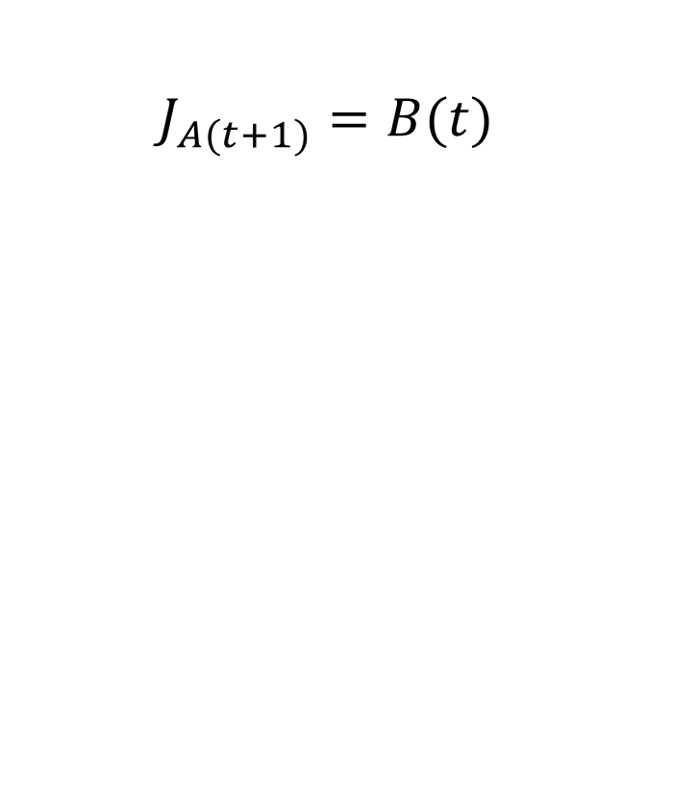
STATE TABLE: PRESENT STATE, INPUT & FLIP-FLOP INPUTS
PRESENT STATE |  | INPUT | FLIP- FLOP INPUT
A | B | x
0 | 0 | 0 | 0
0 | 0 | 1 | 0
0 | 1 | 0 | 1
0 | 1 | 1 | 1
1 | 0 | 0 | 0
1 | 0 | 1 | 0
1 | 1 | 0 | 1
1 | 1 | 1 | 1

Slide 73
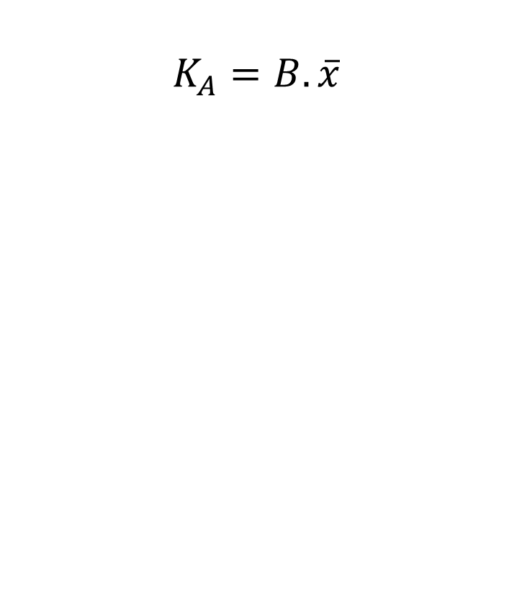
STATE TABLE: PRESENT STATE, INPUT & FLIP-FLOP INPUTS
PRESENT STATE |  | INPUT |  | FLIP- FLOP INPUT
A | B | x
0 | 0 | 0 | 1 | 0 | 0
0 | 0 | 1 | 0 | 0 | 0
0 | 1 | 0 | 1 | 1 | 1
0 | 1 | 1 | 0 | 1 | 0
1 | 0 | 0 | 1 | 0 | 0
1 | 0 | 1 | 0 | 0 | 0
1 | 1 | 0 | 1 | 1 | 1
1 | 1 | 1 | 0 | 1 | 0

Slide 74
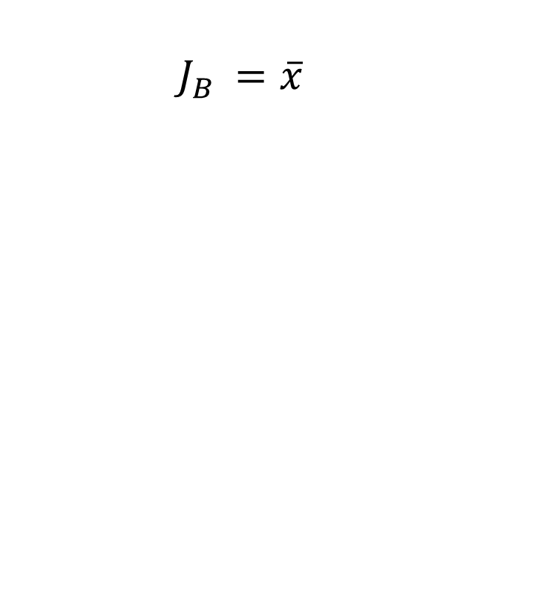
STATE TABLE: PRESENT STATE, INPUT & FLIP-FLOP INPUTS
PRESENT STATE |  | INPUT | FLIP- FLOP INPUT
A | B | x
0 | 0 | 0 | 0 | 0 | 1
0 | 0 | 1 | 0 | 0 | 0
0 | 1 | 0 | 1 | 1 | 1
0 | 1 | 1 | 1 | 0 | 0
1 | 0 | 0 | 0 | 0 | 1
1 | 0 | 1 | 0 | 0 | 0
1 | 1 | 0 | 1 | 1 | 1
1 | 1 | 1 | 1 | 0 | 0

Slide 75
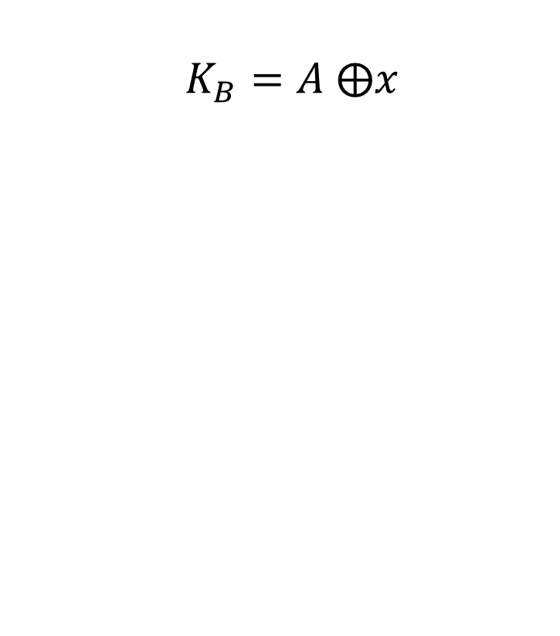
STATE TABLE: PRESENT STATE, INPUT & FLIP-FLOP INPUTS
PRESENT STATE |  | INPUT | FLIP- FLOP INPUT
A | B | x
0 | 0 | 0 | 0 | 0 | 1 | 0
0 | 0 | 1 | 0 | 0 | 0 | 1
0 | 1 | 0 | 1 | 1 | 1 | 0
0 | 1 | 1 | 1 | 0 | 0 | 1
1 | 0 | 0 | 0 | 0 | 1 | 1
1 | 0 | 1 | 0 | 0 | 0 | 0
1 | 1 | 0 | 1 | 1 | 1 | 1
1 | 1 | 1 | 1 | 0 | 0 | 0

Slide 76
STATE TABLE: PRESENT STATE, INPUT, FLIP-FLOP INPUTS & NEXT STATE
PRESENT STATE |  | INPUT | NEXT STATE |  | FLIP- FLOP INPUT
A | B | x | A | B
0 | 0 | 0 | 0 |  | 0 | 0 | 1 | 0
0 | 0 | 1 | 0 |  | 0 | 0 | 0 | 1
0 | 1 | 0 |  |  | 1 | 1 | 1 | 0
0 | 1 | 1 |  |  | 1 | 0 | 0 | 1
1 | 0 | 0 | 1 |  | 0 | 0 | 1 | 1
1 | 0 | 1 | 1 |  | 0 | 0 | 0 | 0
1 | 1 | 0 |  |  | 1 | 1 | 1 | 1
1 | 1 | 1 |  |  | 1 | 0 | 0 | 0
 |  |  | COMMENT
0 | 0 |  | NO CHANGE
0 | 1 | 0 | RESET
1 | 0 | 1 | SET
1 | 1 |  | TOGGLE/ COMPLEMENT

Slide 77
STATE TABLE: PRESENT STATE, INPUT, FLIP-FLOP INPUTS & NEXT STATE
PRESENT STATE |  | INPUT | NEXT STATE |  | FLIP- FLOP INPUT
A | B | x | A | B
0 | 0 | 0 | 0 |  | 0 | 0 | 1 | 0
0 | 0 | 1 | 0 |  | 0 | 0 | 0 | 1
0 | 1 | 0 | 1 |  | 1 | 1 | 1 | 0
0 | 1 | 1 |  |  | 1 | 0 | 0 | 1
1 | 0 | 0 | 1 |  | 0 | 0 | 1 | 1
1 | 0 | 1 | 1 |  | 0 | 0 | 0 | 0
1 | 1 | 0 | 0 |  | 1 | 1 | 1 | 1
1 | 1 | 1 |  |  | 1 | 0 | 0 | 0
 |  |  | COMMENT
0 | 0 |  | NO CHANGE
0 | 1 | 0 | RESET
1 | 0 | 1 | SET
1 | 1 |  | TOGGLE/ COMPLEMENT

Slide 78
STATE TABLE: PRESENT STATE, INPUT, FLIP-FLOP INPUTS & NEXT STATE
PRESENT STATE |  | INPUT | NEXT STATE |  | FLIP- FLOP INPUT
A | B | x | A | B
0 | 0 | 0 | 0 |  | 0 | 0 | 1 | 0
0 | 0 | 1 | 0 |  | 0 | 0 | 0 | 1
0 | 1 | 0 | 1 |  | 1 | 1 | 1 | 0
0 | 1 | 1 | 1 |  | 1 | 0 | 0 | 1
1 | 0 | 0 | 1 |  | 0 | 0 | 1 | 1
1 | 0 | 1 | 1 |  | 0 | 0 | 0 | 0
1 | 1 | 0 | 0 |  | 1 | 1 | 1 | 1
1 | 1 | 1 | 1 |  | 1 | 0 | 0 | 0
 |  |  | COMMENT
0 | 0 |  | NO CHANGE
0 | 1 | 0 | RESET
1 | 0 | 1 | SET
1 | 1 |  | TOGGLE/ COMPLEMENT

Slide 79
STATE TABLE: PRESENT STATE, INPUT, FLIP-FLOP INPUTS & NEXT STATE
PRESENT STATE |  | INPUT | NEXT STATE |  | FLIP- FLOP INPUT
A | B | x | A | B
0 | 0 | 0 | 0 | 1 | 0 | 0 | 1 | 0
0 | 0 | 1 | 0 |  | 0 | 0 | 0 | 1
0 | 1 | 0 | 1 | 1 | 1 | 1 | 1 | 0
0 | 1 | 1 | 1 |  | 1 | 0 | 0 | 1
1 | 0 | 0 | 1 |  | 0 | 0 | 1 | 1
1 | 0 | 1 | 1 |  | 0 | 0 | 0 | 0
1 | 1 | 0 | 0 |  | 1 | 1 | 1 | 1
1 | 1 | 1 | 1 |  | 1 | 0 | 0 | 0
 |  |  | COMMENT
0 | 0 |  | NO CHANGE
0 | 1 | 0 | RESET
1 | 0 | 1 | SET
1 | 1 |  | TOGGLE/ COMPLEMENT

Slide 80
STATE TABLE: PRESENT STATE, INPUT, FLIP-FLOP INPUTS & NEXT STATE
PRESENT STATE |  | INPUT | NEXT STATE |  | FLIP- FLOP INPUT
A | B | x | A | B
0 | 0 | 0 | 0 | 1 | 0 | 0 | 1 | 0
0 | 0 | 1 | 0 | 0 | 0 | 0 | 0 | 1
0 | 1 | 0 | 1 | 1 | 1 | 1 | 1 | 0
0 | 1 | 1 | 1 | 0 | 1 | 0 | 0 | 1
1 | 0 | 0 | 1 |  | 0 | 0 | 1 | 1
1 | 0 | 1 | 1 |  | 0 | 0 | 0 | 0
1 | 1 | 0 | 0 |  | 1 | 1 | 1 | 1
1 | 1 | 1 | 1 |  | 1 | 0 | 0 | 0
 |  |  | COMMENT
0 | 0 |  | NO CHANGE
0 | 1 | 0 | RESET
1 | 0 | 1 | SET
1 | 1 |  | TOGGLE/ COMPLEMENT

Slide 81
STATE TABLE: PRESENT STATE, INPUT, FLIP-FLOP INPUTS & NEXT STATE
PRESENT STATE |  | INPUT | NEXT STATE |  | FLIP- FLOP INPUT
A | B | x | A | B
0 | 0 | 0 | 0 | 1 | 0 | 0 | 1 | 0
0 | 0 | 1 | 0 | 0 | 0 | 0 | 0 | 1
0 | 1 | 0 | 1 | 1 | 1 | 1 | 1 | 0
0 | 1 | 1 | 1 | 0 | 1 | 0 | 0 | 1
1 | 0 | 0 | 1 | 0 | 0 | 0 | 1 | 1
1 | 0 | 1 | 1 |  | 0 | 0 | 0 | 0
1 | 1 | 0 | 0 | 0 | 1 | 1 | 1 | 1
1 | 1 | 1 | 1 |  | 1 | 0 | 0 | 0
 |  |  | COMMENT
0 | 0 |  | NO CHANGE
0 | 1 | 0 | RESET
1 | 0 | 1 | SET
1 | 1 |  | TOGGLE/ COMPLEMENT

Slide 82
STATE TABLE: PRESENT STATE, INPUT, FLIP-FLOP INPUTS & NEXT STATE
PRESENT STATE |  | INPUT | NEXT STATE |  | FLIP- FLOP INPUT
A | B | x | A | B
0 | 0 | 0 | 0 | 1 | 0 | 0 | 1 | 0
0 | 0 | 1 | 0 | 0 | 0 | 0 | 0 | 1
0 | 1 | 0 | 1 | 1 | 1 | 1 | 1 | 0
0 | 1 | 1 | 1 | 0 | 1 | 0 | 0 | 1
1 | 0 | 0 | 1 | 0 | 0 | 0 | 1 | 1
1 | 0 | 1 | 1 | 1 | 0 | 0 | 0 | 0
1 | 1 | 0 | 0 | 0 | 1 | 1 | 1 | 1
1 | 1 | 1 | 1 | 1 | 1 | 0 | 0 | 0
 |  |  | COMMENT
0 | 0 |  | NO CHANGE
0 | 1 | 0 | RESET
1 | 0 | 1 | SET
1 | 1 |  | TOGGLE/ COMPLEMENT

Slide 83
STATE TABLE: PRESENT STATE, INPUT, FLIP-FLOP INPUTS & NEXT STATE
PRESENT STATE |  | INPUT | NEXT STATE |  | FLIP- FLOP INPUT
A | B | x | A | B
0 | 0 | 0 | 0 | 1 | 0 | 0 | 1 | 0
0 | 0 | 1 | 0 | 0 | 0 | 0 | 0 | 1
0 | 1 | 0 | 1 | 1 | 1 | 1 | 1 | 0
0 | 1 | 1 | 1 | 0 | 1 | 0 | 0 | 1
1 | 0 | 0 | 1 | 0 | 0 | 0 | 1 | 1
1 | 0 | 1 | 1 | 1 | 0 | 0 | 0 | 0
1 | 1 | 0 | 0 | 0 | 1 | 1 | 1 | 1
1 | 1 | 1 | 1 | 1 | 1 | 0 | 0 | 0

Slide 84
STATE TABLE: PRESENT STATE, INPUT, FLIP-FLOP INPUTS & NEXT STATE
PRESENT STATE |  | INPUT | NEXT STATE
A | B | x | A | B
0 | 0 | 0 | 0 | 1
0 | 0 | 1 | 0 | 0
0 | 1 | 0 | 1 | 1
0 | 1 | 1 | 1 | 0
1 | 0 | 0 | 1 | 0
1 | 0 | 1 | 1 | 1
1 | 1 | 0 | 0 | 0
1 | 1 | 1 | 1 | 1

Slide 85
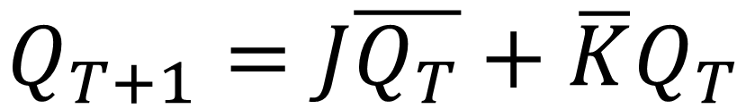
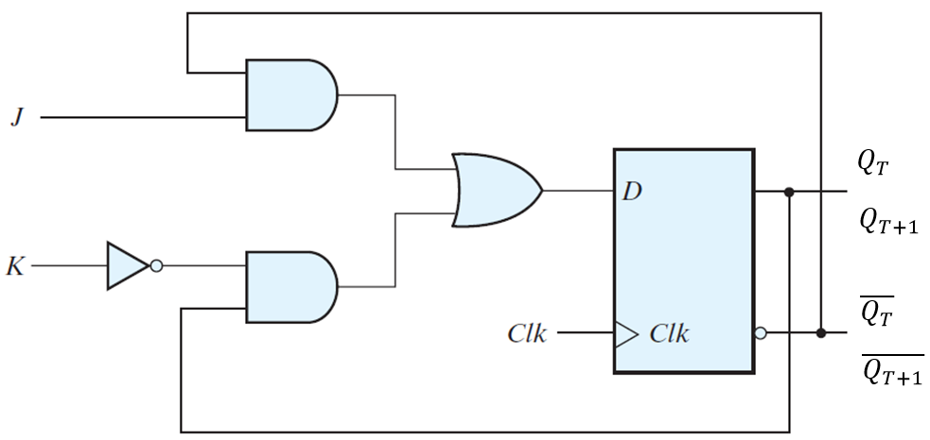
JK-FLIP-FLOP

Slide 86
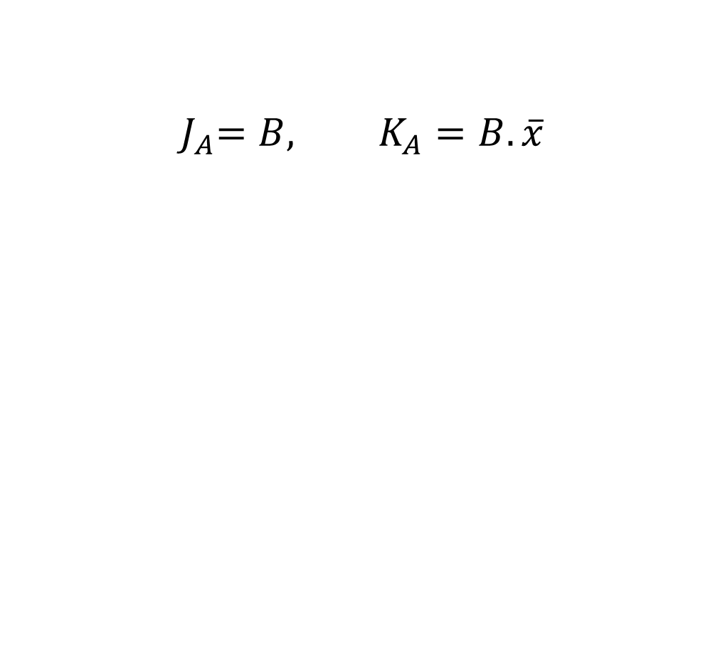



STATE TABLE: PRESENT STATE, INPUT, NEXT STATE FOR FLIP FLOP A
PRESENT STATE |  | INPUT
A | B | x
0 | 0 | 0
0 | 0 | 1
0 | 1 | 0
0 | 1 | 1
1 | 0 | 0
1 | 0 | 1
1 | 1 | 0
1 | 1 | 1

Slide 87




STATE TABLE: PRESENT STATE, INPUT, NEXT STATE FOR FLIP FLOP A
PRESENT STATE |  | INPUT | NEXT STATE
A | B | x | A | B
0 | 0 | 0 | 0
0 | 0 | 1
0 | 1 | 0
0 | 1 | 1
1 | 0 | 0
1 | 0 | 1
1 | 1 | 0
1 | 1 | 1

Slide 88

STATE TABLE: PRESENT STATE, INPUT, NEXT STATE FOR FLIP FLOP A
PRESENT STATE |  | INPUT | NEXT STATE
A | B | x | A | B
0 | 0 | 0 | 0
0 | 0 | 1 | 0
0 | 1 | 0
0 | 1 | 1
1 | 0 | 0
1 | 0 | 1
1 | 1 | 0
1 | 1 | 1

Slide 89



STATE TABLE: PRESENT STATE, INPUT, NEXT STATE FOR FLIP FLOP A
PRESENT STATE |  | INPUT | NEXT STATE
A | B | x | A | B
0 | 0 | 0 | 0
0 | 0 | 1 | 0
0 | 1 | 0 | 1
0 | 1 | 1 | 1
1 | 0 | 0
1 | 0 | 1
1 | 1 | 0
1 | 1 | 1

Slide 90


STATE TABLE: PRESENT STATE, INPUT, NEXT STATE FOR FLIP FLOP A
PRESENT STATE |  | INPUT | NEXT STATE
A | B | x | A | B
0 | 0 | 0 | 0
0 | 0 | 1 | 0
0 | 1 | 0 | 1
0 | 1 | 1 | 1
1 | 0 | 0 | 1
1 | 0 | 1 | 1
1 | 1 | 0
1 | 1 | 1

Slide 91






STATE TABLE: PRESENT STATE, INPUT, NEXT STATE FOR FLIP FLOP A
PRESENT STATE |  | INPUT | NEXT STATE
A | B | x | A | B
0 | 0 | 0 | 0
0 | 0 | 1 | 0
0 | 1 | 0 | 1
0 | 1 | 1 | 1
1 | 0 | 0 | 1
1 | 0 | 1 | 1
1 | 1 | 0 | 0
1 | 1 | 1 | 1

Slide 92




STATE TABLE: PRESENT STATE, INPUT, NEXT STATE FOR FLIP FLOP B
PRESENT STATE |  | INPUT | NEXT STATE
A | B | x | A | B
0 | 0 | 0 | 0
0 | 0 | 1 | 0
0 | 1 | 0 | 1
0 | 1 | 1 | 1
1 | 0 | 0 | 1
1 | 0 | 1 | 1
1 | 1 | 0 | 0
1 | 1 | 1 | 1

Slide 93



STATE TABLE: PRESENT STATE, INPUT, NEXT STATE FOR FLIP FLOP B
PRESENT STATE |  | INPUT | NEXT STATE
A | B | x | A | B
0 | 0 | 0 | 0 | 1
0 | 0 | 1 | 0
0 | 1 | 0 | 1
0 | 1 | 1 | 1
1 | 0 | 0 | 1
1 | 0 | 1 | 1
1 | 1 | 0 | 0
1 | 1 | 1 | 1

Slide 94
STATE TABLE: PRESENT STATE, INPUT, NEXT STATE FOR FLIP FLOP A
PRESENT STATE |  | INPUT | NEXT STATE
A | B | x | A | B
0 | 0 | 0 | 0 | 1
0 | 0 | 1 | 0 | 0
0 | 1 | 0 | 1 | 1
0 | 1 | 1 | 1 | 0
1 | 0 | 0 | 1 | 1
1 | 0 | 1 | 1 | 0
1 | 1 | 0 | 0 | 0
1 | 1 | 1 | 1 | 1

Slide 95
STATE TABLE: PRESENT STATE, INPUT, NEXT STATE
PRESENT STATE |  | INPUT | NEXT STATE
A | B | x | A | B
0 | 0 | 0 | 0 | 1
0 | 0 | 1 | 0 | 0
0 | 1 | 0 | 1 | 1
0 | 1 | 1 | 1 | 0
1 | 0 | 0 | 1 | 1
1 | 0 | 1 | 1 | 0
1 | 1 | 0 | 0 | 0
1 | 1 | 1 | 1 | 1

Slide 96
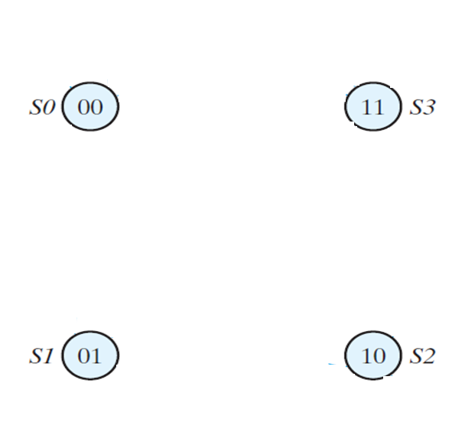
STATE DIAGRAM
PRESENT STATE |  | INPUT | NEXT STATE
A | B | x | A | B
0 | 0 | 0 | 0 | 1
0 | 0 | 1 | 0 | 0
0 | 1 | 0 | 1 | 1
0 | 1 | 1 | 1 | 0
1 | 0 | 0 | 1 | 1
1 | 0 | 1 | 1 | 0
1 | 1 | 0 | 0 | 0
1 | 1 | 1 | 1 | 1

Slide 97
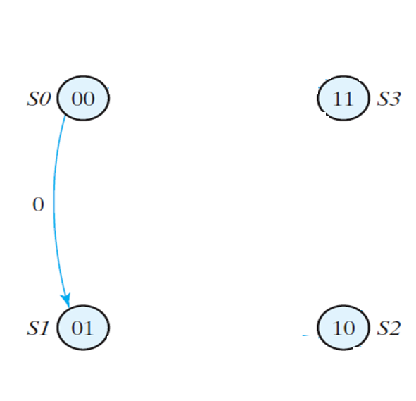
STATE DIAGRAM
PRESENT STATE |  | INPUT | NEXT STATE
A | B | x | A | B
0 | 0 | 0 | 0 | 1
0 | 0 | 1 | 0 | 0
0 | 1 | 0 | 1 | 1
0 | 1 | 1 | 1 | 0
1 | 0 | 0 | 1 | 1
1 | 0 | 1 | 1 | 0
1 | 1 | 0 | 0 | 0
1 | 1 | 1 | 1 | 1

Slide 98
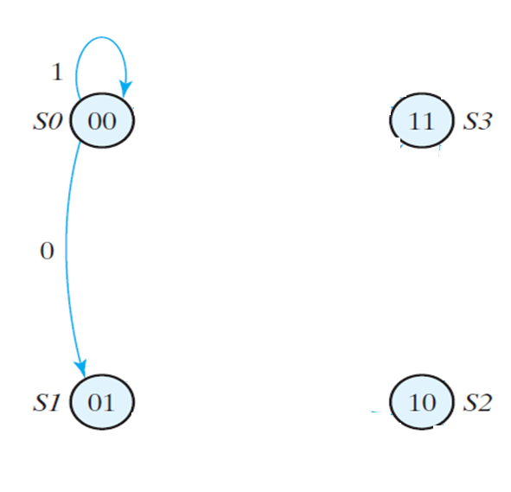
STATE DIAGRAM
PRESENT STATE |  | INPUT | NEXT STATE
A | B | x | A | B
0 | 0 | 0 | 0 | 1
0 | 0 | 1 | 0 | 0
0 | 1 | 0 | 1 | 1
0 | 1 | 1 | 1 | 0
1 | 0 | 0 | 1 | 1
1 | 0 | 1 | 1 | 0
1 | 1 | 0 | 0 | 0
1 | 1 | 1 | 1 | 1

Slide 99
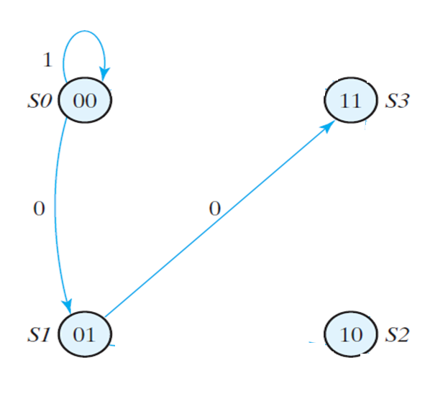
STATE DIAGRAM
PRESENT STATE |  | INPUT | NEXT STATE
A | B | x | A | B
0 | 0 | 0 | 0 | 1
0 | 0 | 1 | 0 | 0
0 | 1 | 0 | 1 | 1
0 | 1 | 1 | 1 | 0
1 | 0 | 0 | 1 | 1
1 | 0 | 1 | 1 | 0
1 | 1 | 0 | 0 | 0
1 | 1 | 1 | 1 | 1

Slide 100
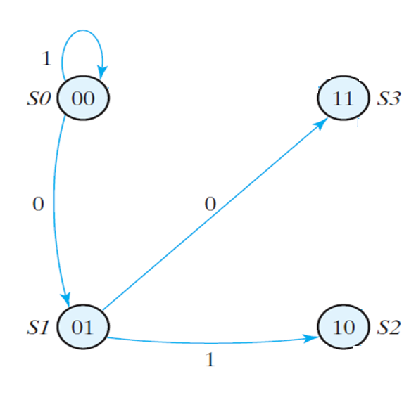
STATE DIAGRAM
PRESENT STATE |  | INPUT | NEXT STATE
A | B | x | A | B
0 | 0 | 0 | 0 | 1
0 | 0 | 1 | 0 | 0
0 | 1 | 0 | 1 | 1
0 | 1 | 1 | 1 | 0
1 | 0 | 0 | 1 | 1
1 | 0 | 1 | 1 | 0
1 | 1 | 0 | 0 | 0
1 | 1 | 1 | 1 | 1

Slide 101
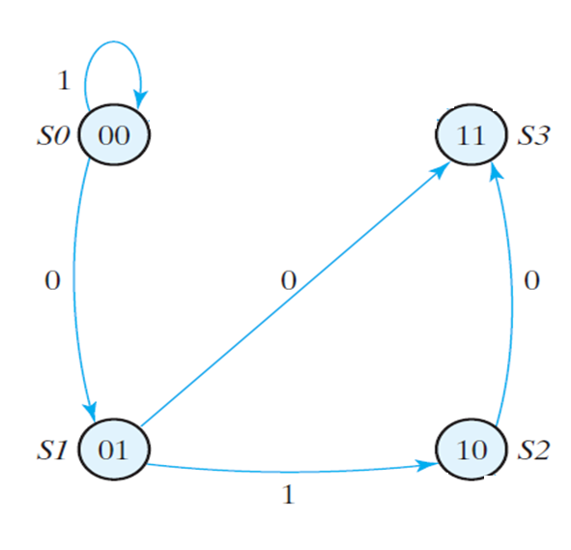
STATE DIAGRAM
PRESENT STATE |  | INPUT | NEXT STATE
A | B | x | A | B
0 | 0 | 0 | 0 | 1
0 | 0 | 1 | 0 | 0
0 | 1 | 0 | 1 | 1
0 | 1 | 1 | 1 | 0
1 | 0 | 0 | 1 | 1
1 | 0 | 1 | 1 | 0
1 | 1 | 0 | 0 | 0
1 | 1 | 1 | 1 | 1

Slide 102
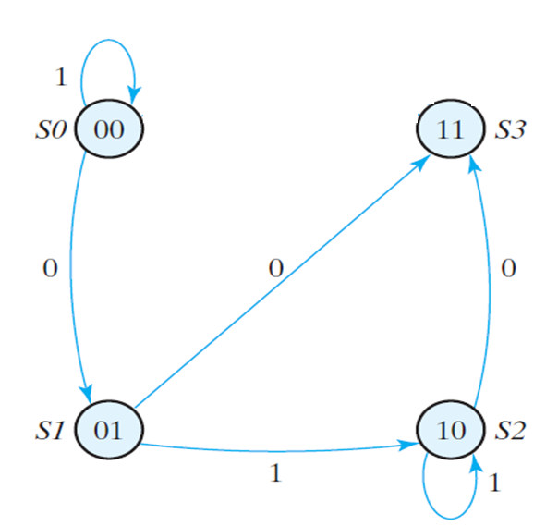
STATE DIAGRAM
PRESENT STATE |  | INPUT | NEXT STATE
A | B | x | A | B
0 | 0 | 0 | 0 | 1
0 | 0 | 1 | 0 | 0
0 | 1 | 0 | 1 | 1
0 | 1 | 1 | 1 | 0
1 | 0 | 0 | 1 | 1
1 | 0 | 1 | 1 | 0
1 | 1 | 0 | 0 | 0
1 | 1 | 1 | 1 | 1

Slide 103
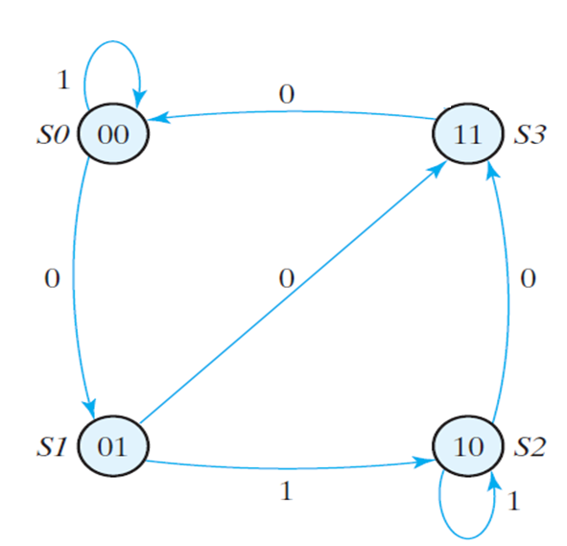
STATE DIAGRAM
PRESENT STATE |  | INPUT | NEXT STATE
A | B | x | A | B
0 | 0 | 0 | 0 | 1
0 | 0 | 1 | 0 | 0
0 | 1 | 0 | 1 | 1
0 | 1 | 1 | 1 | 0
1 | 0 | 0 | 1 | 1
1 | 0 | 1 | 1 | 0
1 | 1 | 0 | 0 | 0
1 | 1 | 1 | 1 | 1

Slide 104
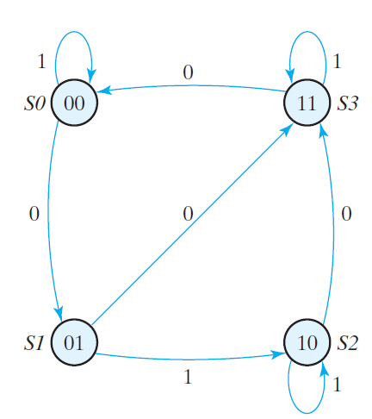
STATE DIAGRAM
PRESENT STATE |  | INPUT | NEXT STATE
A | B | x | A | B
0 | 0 | 0 | 0 | 1
0 | 0 | 1 | 0 | 0
0 | 1 | 0 | 1 | 1
0 | 1 | 1 | 1 | 0
1 | 0 | 0 | 1 | 1
1 | 0 | 1 | 1 | 0
1 | 1 | 0 | 0 | 0
1 | 1 | 1 | 1 | 1

Slide 105
STATE DIAGRAM

Slide 106
Thanks

